Slide 1



Data Analytics
Unit 7 - Storytelling with Data, Web Scraping, APIs, AB Testing
NOV - DEC 2020 | BERLIN

Slide 2

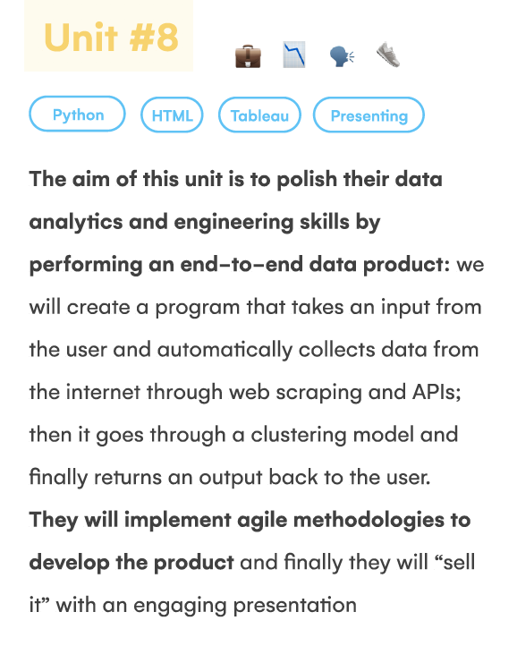
What will I learn in this unit?

Slide 3
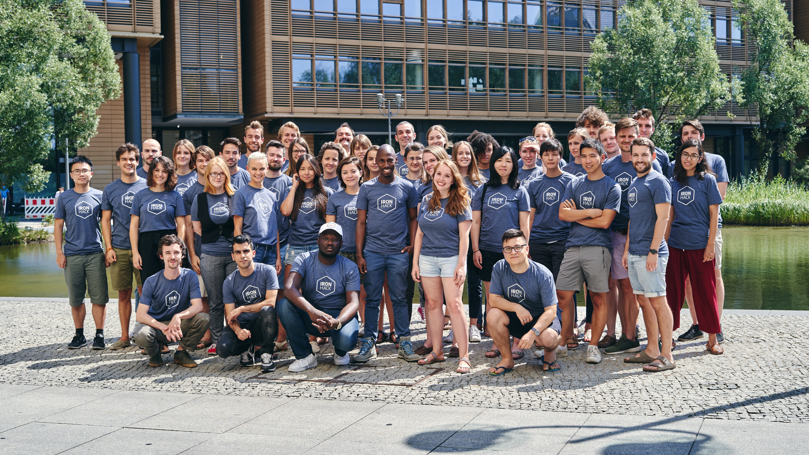

Fun day - Monday

Slide 4



Morning lecture
Afternoon Session
Gallery
Group Project
Covid-19 and Human Movement
4.30-4.45 Break
4.45 Gallery of Data Stories
LFB Best of class dashboards
Why do we tell stories?
Zoom in Zoom out
Data storytelling
Narrative Arc
Tips on Tableau Story setup
--Project intro--
(split into groups)

Slide 5

Why do we tell stories?
Value and meaning
Oldest tradition
Learn its important in childhood
To be remembered - emotion causes memory
Makes us human - relate the story of everything - how we relate to things- impact!
Connection - is a story - make something relevant - you feel involved
Communicate ideas - shared reality/ history
Tells you who you are
Explain our world
Distinctly human trait - religion, nationhood
Identifies us and other
Information - warnings - morality

Slide 6
What makes a good story?
Clarity
Visuals are vivid
Tone
Humour
Strength in storyline - peak
Structure
Common thread
Relatability
Shock , Surprise, unexpected
Elicit an emotional reactions

Slide 7

Zoom in Zoom out

Slide 8


Slide 9
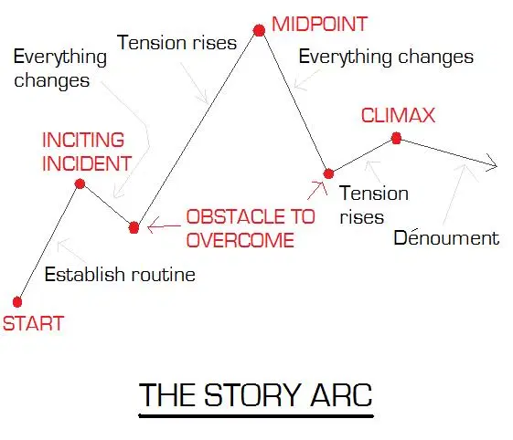

Slide 10
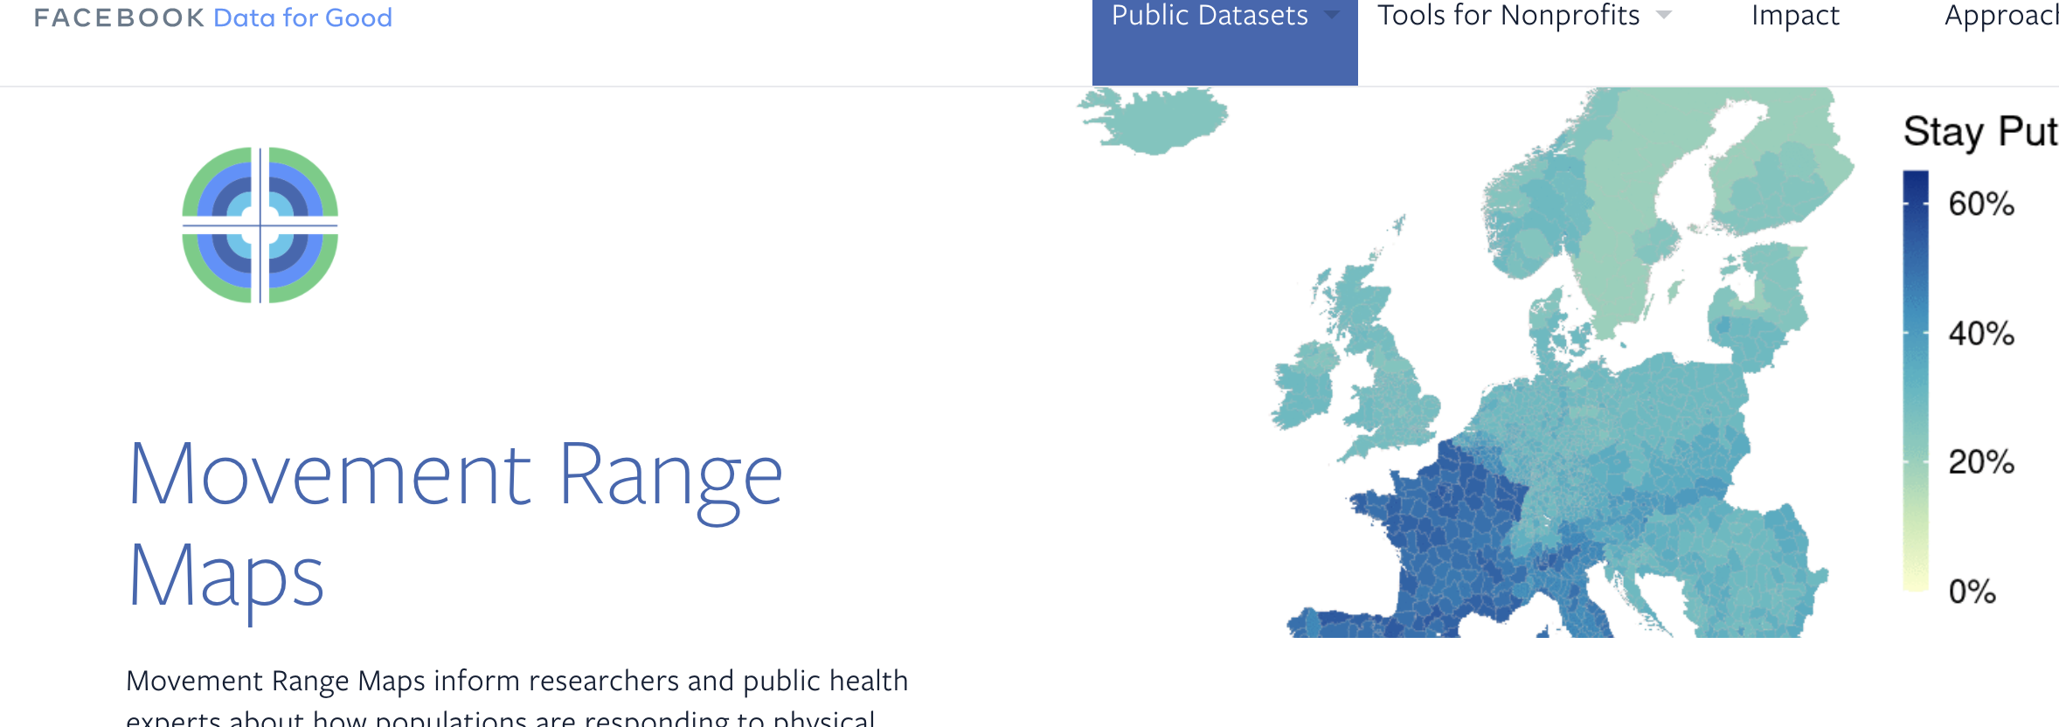

Slide 11
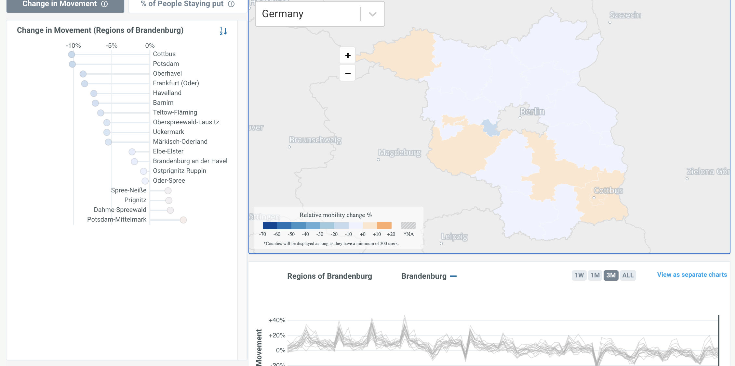

Slide 12
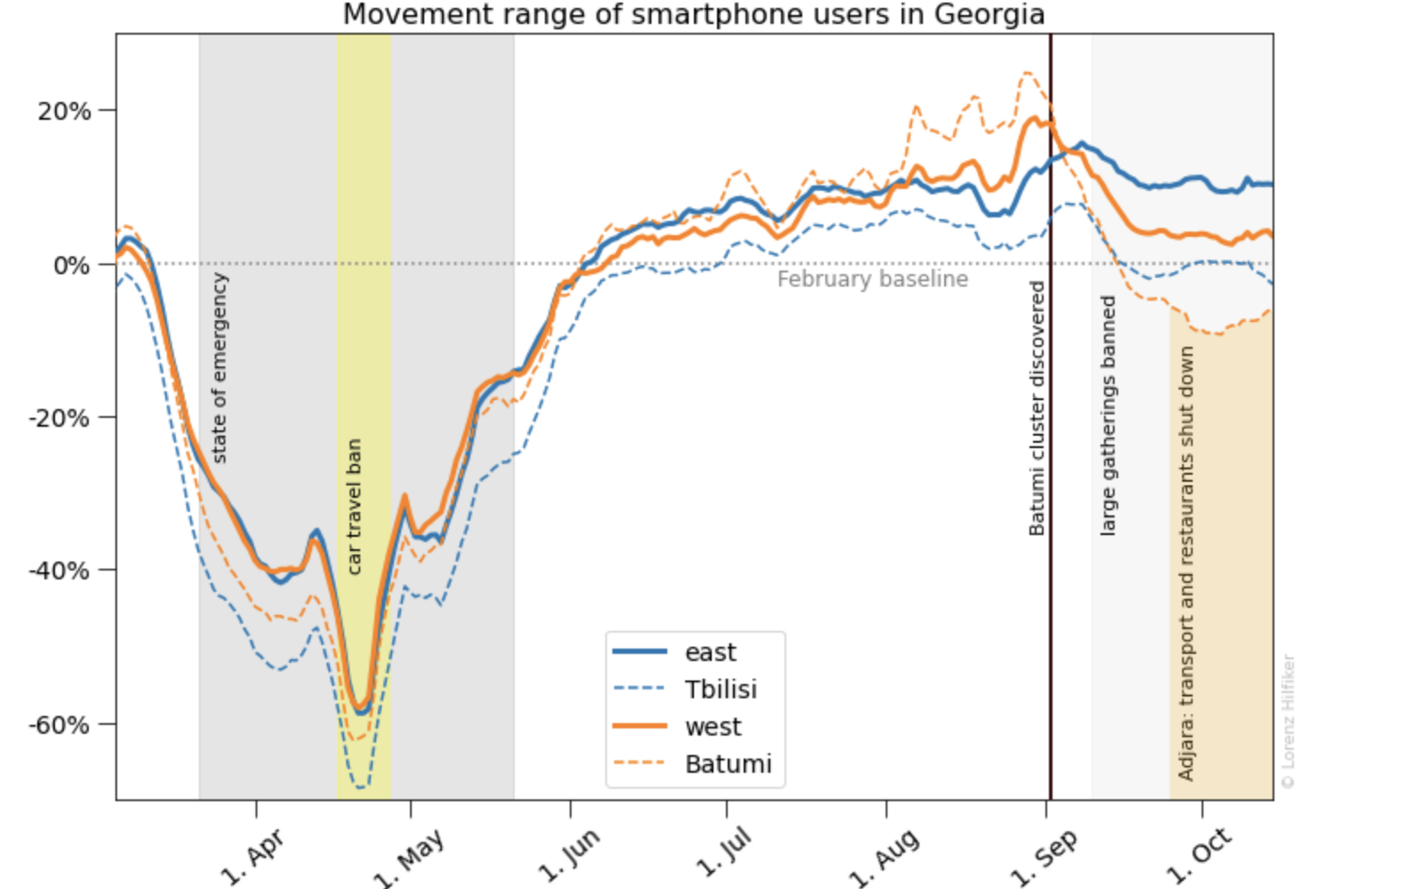

Slide 13

Two Day - Tuesday

Slide 14


Morning session
Afternoon Session
Lab Session
Introduction to WebScraping
Case Study explained
When do we need it? 8.01.1
Html basics
Tags, structure, inspect
Next steps for newbies
Beautiful Soup & Parsing 8.01.2
Scraped data & pandas
Andres presentation- final project - and deep learning
Lunch 12:30 - 1:30
Review of Pandas and Getting started with Web Scraping with Flo
->TA assisted Labs from 16:15 -
8.01 (inside lesson unit in Day 2 of student portal) HTML Web Scraping
Web Scraping -optional
HTML Tutorial - optional
CSS Level 32 - optional

Slide 15
Project flowchart - GNOD Case Study
Yes
Recommend another “hot” song
Is it currently “hot”?
User inputs song
No
Recommend “similar” song

Slide 16


1st prototype
Data collection
“Hot” songs
Web scraping
Yes
Recommend another “hot” song
Is it currently “hot”?
User inputs song
No recommendation
No
Notes:
Show this on day 2

Slide 17
When to use web scraping
No API - if API is available, normally better to use it
Automation Needed - of course we can copy + paste but … ugh
Less Restricted - eg no API account required, less rules to follow (eg limit on # requests)
ISSUES
You depend on the structure of the site being scraped
Can be messy
Can change overnight
Website protections

Slide 18
When to use web scraping
Ideas for sites and use cases
Yellow pages - addresses of companies in a city
Reddit
Asos - images of menswear
Social networks
Amazon - prices of products
Bbc news - see how countries are described
Airbnb - apartments and room prices / sizes / locations - impact
Twitter - Bit coin all time high - look for acronyms
Skyscanner - demand forecasting - prices - best times to book
Linkedin - for filtering jobs
Web scraping slides

Slide 19
Basic html (tree) structure
<!DOCTYPE html>
<html>
<head>
<title>Page Title</title>
</head>
<body>
<h1>My First Heading</h1>
<p>My first paragraph.</p>
<p>My second paragraph has a <b>bold<b> word!</p>
</body>
</html>

Slide 20
An HTML element is defined by a start tag, some content and an end tag. When web scraping we will mostly be interested in the content, but the tag will be crucial in locating the content.
Tags are just keywords that encapsulate some content. They tell the web browser how to display the content. Some examples of common tags are:
<!DOCTYPE> and <html> define the document type
<head>, <title> and <body> define the main parts of the document
<h1> to <h6> define headings
<p> defines a paragraph
<b> will make its contents bold

Slide 21
Tags , attributes and value pairs
<a href="https://www.ironhack.com/">a data bootcamp</a>

Slide 22
Attributes you need to know
The id attribute: unless the creator of the site has broken basic conventions, id's are unique. That makes them the best attributes for locating data in a site. If you discover that the piece of information you're trying to collect is an element that has an id, your job will be SO EASY. Bad news though: that doesn't happen often.
The class attribute: it's often used to give style to multiple elements. For example, go to https://xkcd.com/. Notice how there are elements like "boxes" or "buttons" that are styled similarly in a site. Instead of defining the style for each one of these elements, the style for all the "boxes" might be defined in a different script (a CSS document), and it just points to all elements with class = "box". This is often a useful way to locate content inside of an HTML script.
Notes:
Understanding the HTML tree structure is key to web scraping, but that doesn't mean we should know what each tag or attribute is supposed to do. It might help to get the logic underlying that site, but ultimately we don't care much if the data we're looking for is under a <div> or a <li> tag, we just have to detect it and write the code that grabs it.

Slide 23
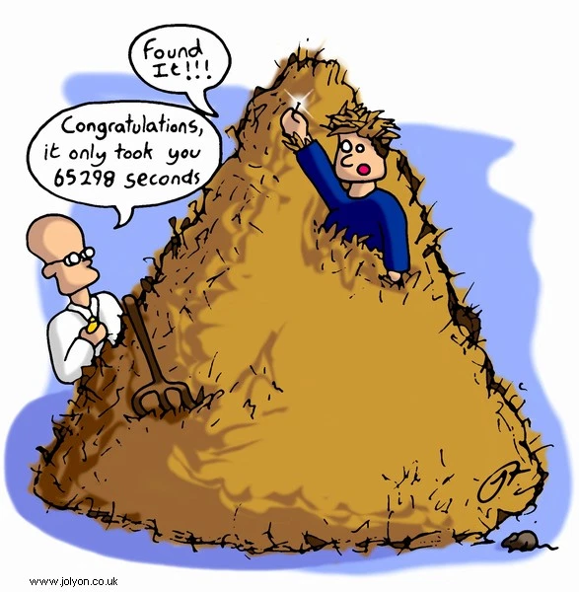

Slide 24
The dormouse’s story

Slide 25
Wikipedia - languages
Notes:
Cmd shift c _ elements _ hover over html code to see webpage light up
Mouse pointer on square top right to dynamically navigate from site to html and vice versa
Ignore the style content

Slide 26

‘Hump day’ Wednesday

Slide 27

Morning session
Afternoon Session
Lab Session
Finish lecture - skyscanner API
3:15 Mapping using Folium with Brecht
Defining your final project & MVP as a brief - due PM friday
Activity 8.04.3 - skyscanner
Fresh Brain Lab time -10:30
Finish working on web scraping labs from Tues
Web scraping extended - multiple pages
Project definition & data assessment
Intro to APIs 8.04.2, 3
Lunch 12:50 - 14:00
->TA assisted Labs from 16:15-
8.02 Web Scraping extended
8.03 Intro to APIs - optional
(Both are inside respective lesson unit in Day 2 of student portal)
[LAB] Advanced Web Scraping - optional see student portal
Notes:
Thurs - Consulting skills workshop with Sian (small group) - I will run two separate sessions

Slide 28
Project flowchart - GNOD Case Study
Yes
Recommend another “hot” song
Is it currently “hot”?
User inputs song
No
Recommend “similar” song

Slide 29

Scraping multiple pages
IMDB - notebook provided
Assemble urls to send multiple requests
Using sleep()
Pull 631 movie titles and synopsis
US presidents - your turn
Collect all wikipedia links
Scrape each page
Organise in data frame
Extract some facts
Using error handling

Slide 30
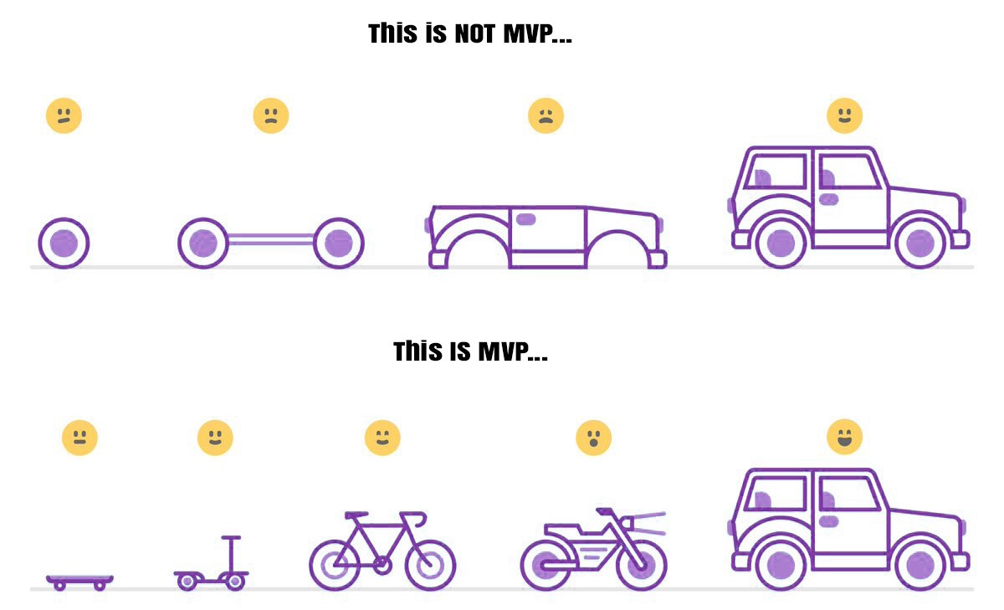
Your first prototype
Specifics of your GNOD product
What’s your MVP?
Create your python pipeline
User experience
Architecture
Scheduling
Testing

Slide 31
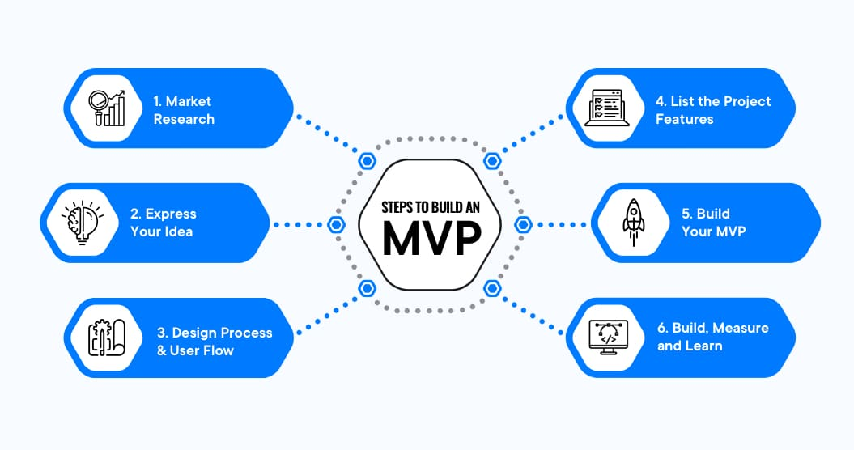

Slide 32
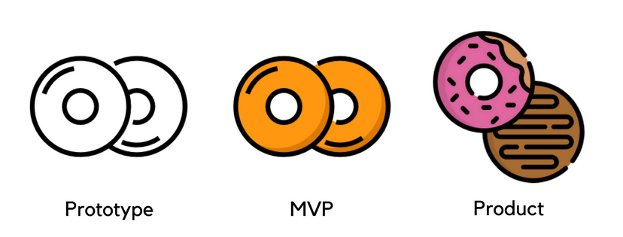
Medium article - step by step

Slide 33
1st prototype
Data collection
“Hot” songs
Web scraping
Yes
Recommend another “hot” song
Is it currently “hot”?
User inputs song
No recommendation
No
Notes:
Show this on day 2

Slide 34

2nd prototype
API
Data collection
Modelling
“Hot” songs
Audio features
Song clusters
Web scraping
Yes
Recommend another “hot” song
Is it currently “hot”?
User inputs song
No
Find audio features of the song
Recommend song from same cluster
Notes:
Show this on day 3-4

Slide 35
SONGS DATABASE
User inputs song
Cluster 1
Cluster 2
Cluster 3
API
Cluster n
Cluster 4
Audio features

Slide 36
User experience:
What happens if the user inputs a song that doesn't exist?
What do we do with songs that have the same name, but a different artist?
How do we deal with typos?

Slide 37
Architecture:
Do we build the interaction with the user in the same notebook as the web-scraping?
Where do we store the scraped songs?

Slide 38
Scheduling / Automation:
Should we scrape billboard / wikipedia every time a user sends a request?
Testing:
Does it work when you test it with a real user (a classmate or colleague or relative)?

Slide 39
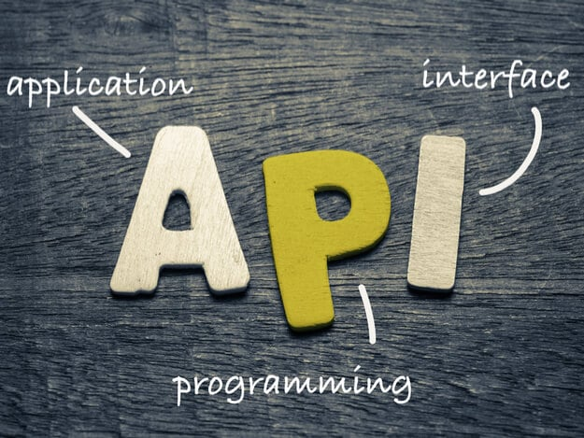
Intro to APIs
What is it - in plain english
REST API
Requests Library - try 3 web pages
Status Codes review
Skyscanner API- sign up and use
Understanding JSON
Apply this to the Skyscanner API

Slide 40
Intro to APIs
----------Why do we need this for the Gnod Case study?
Our company Gnod is interested in grouping clients by their musical interests.
To do that we will need to collect data from musical sites so we can understand better this topic.
We have heard that the Spotify API is pretty good for this kind of data collection so we will take a look at it.
If it's not enough or we need more information, we will try other data collection methods.

Slide 41
Intro to APIs
API stands for Application Programming Interface.
At some point or another, most large companies have built APIs for their customers, or for internal use.
Every page on the internet is stored somewhere on a remote server.
...you can spin up a server on your laptop capable of serving an entire website to the Web
When you type www.facebook.com into your browser, a request goes out to Facebook’s remote server. Once your browser receives the response, it interprets the code and displays the page.- the browser interacts with a remote server’s API.
Kudos to this site https://www.freecodecamp.org/news/what-is-an-api-in-english-please-b880a3214a82/

Slide 42
Intro to APIs
An API isn’t the same as the remote server — rather it is the part of the server that receives requests and sends responses.
You’ve probably heard of companies packaging APIs as products. For example, Weather Services like OpenWeather sells access to APIs
In technical terms, the difference is the format of the request and the response- your browser expects html, and gets data eg json
When a company offers an API to their customers, it just means that they’ve built a set of dedicated URLs that return pure data responses
Some APIs dont need access tokens - eg github
Kudos to this site https://www.freecodecamp.org/news/what-is-an-api-in-english-please-b880a3214a82/

Slide 43
APIs- better than a csv file?
The data changes quickly. Stock price data or betting houses are a perfect example for it. It doesn’t really make sense to regenerate a dataset and download it every second. It is incredibly expensive and wouldn't be efficient nor effective at all, as it would be not just expensive but also really slow.
You want just a piece of all your data. Imagine you want to download your facebook pictures. Without an API you would need to download the entire Facebook dataset, and that doesn't really make a lot of sense since we have APIs to filter that information.
Repeated computation involved. The Spotify API that can tell you the genre of a piece of music. You could theoretically create your own classifier, and use it to compute music categories, but you’ll never have as much data as Spotify does, saving a lot of space.
Notes:
Automate efficiency adaptation

Slide 44
RESTful APIs
REpresentational State Transfer
Frequently used web service method
There are some Architectural constraints.
This generalizes the use of HTTP, making requests to specific URLs
We will use this tool to interact with an API
Using GET and POST
Notes:
Automate efficiency adaptation

Slide 45
Lets try web pages to retrieve json - which status code comes back?
Import requests and run a url request to the below webpages
google
NBA
rottentomatoes

Slide 46
Request status codes
200: Everything went okay and the result has been returned (if any).
301: The server is redirecting you to a different endpoint. This can happen when a company switches domain names, or an endpoint name is changed.
400: The server thinks you made a bad request. This happens when you don’t send along the right data, among other things.
401: You are not properly authenticated.
403: The resource you’re trying to access is forbidden: you don’t have the right permissions to get it.
404: The resource you tried to access doesn't exist.
503: The server can't handle the request. </details>

Slide 48

Nearly there Thursday

Slide 49

Morning session
Afternoon Session
Lab Session
->TA assisted Labs from 15:00
[Lab] API Wrappers (or data merge and dedupe) - Create collection- solution provided
[Lab] Coingecko (optional)
[Lab] Intro to Unsupervised Learning - review
[Lab] Iris Data (optional)
Spotipy installation
8.05.1 Spotify registration and App setup (Client ID + Secret)
9:30 Guest Lecture - Tania
API wrappers(Spotipy)8.05.2
Track dictionary 8.05.3
(OR) Spotify data on Kaggle
Lunch 12:50 - 14:15
Introduction to Unsupervised Learning
Debates in machine learning - ethics - optional
Consulting skills workshop with Sian 1 (3.30-4.15pm)

Slide 50
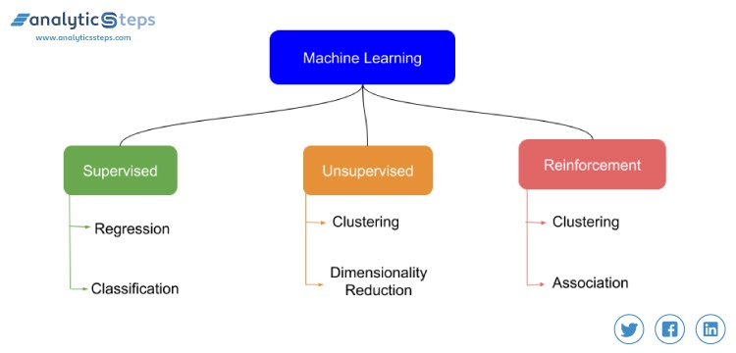

Slide 51
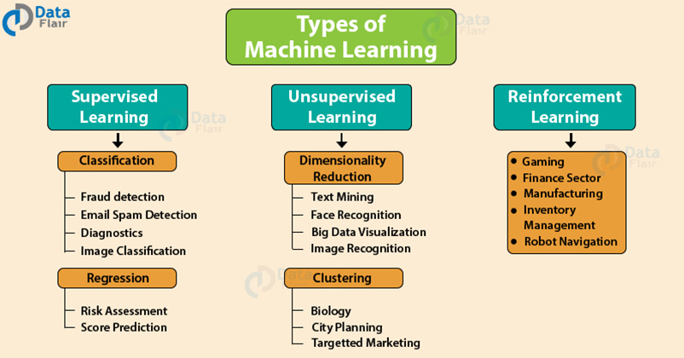

Slide 52
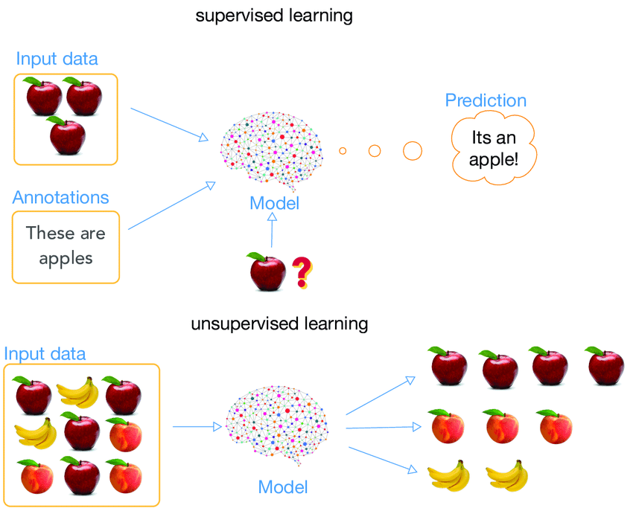

Slide 53
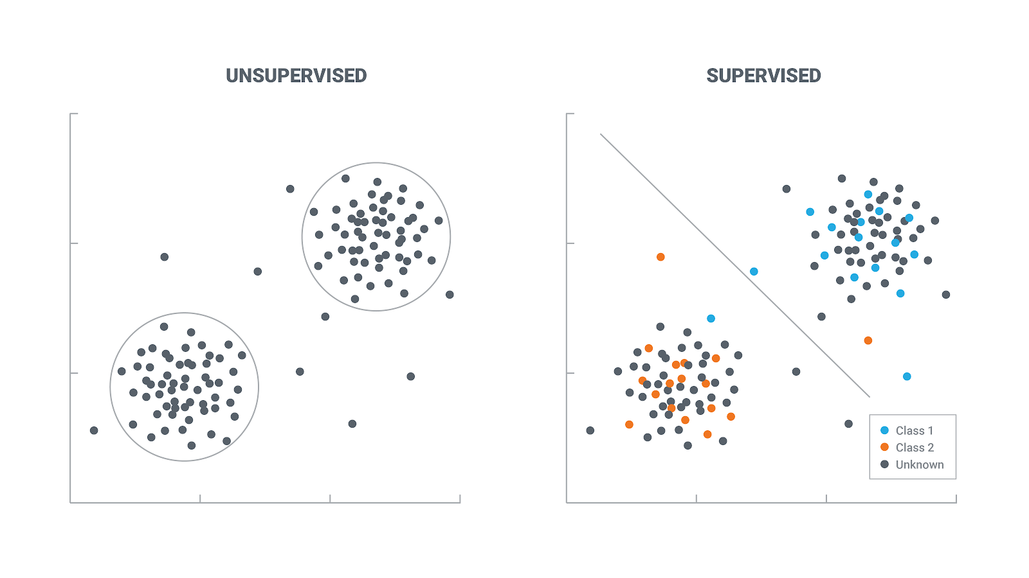

Slide 54
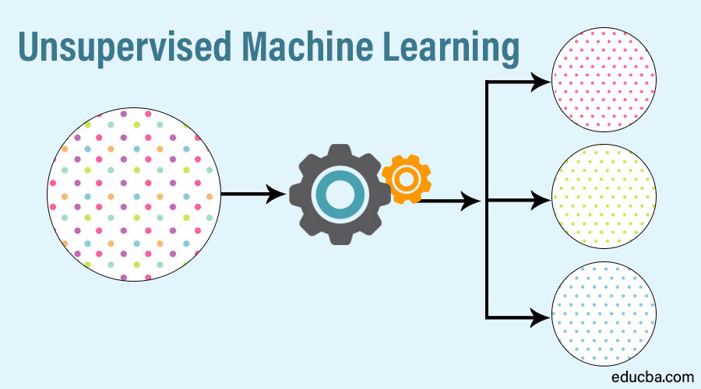
Unsupervised learning is a type of machine learning algorithm used to draw inferences from datasets consisting of input data without labeled responses.
The most common unsupervised learning method is cluster analysis, which is used for exploratory data analysis to find hidden patterns or grouping in data. The clusters are modeled using a measure of similarity which is defined upon metrics such as Euclidean or probabilistic distance.

Slide 55
Common clustering algorithms include:
Hierarchical clustering: builds a multilevel hierarchy of clusters by creating a cluster tree
k-Means clustering: partitions data into k distinct clusters based on distance to the centroid of a cluster
Gaussian mixture models: models clusters as a mixture of multivariate normal density components
Self-organizing maps: uses neural networks that learn the topology and distribution of the data
Hidden Markov models: uses observed data to recover the sequence of states

Slide 56
Pros of Unsupervised Machine Learning
It can detect what human eyes can not understand
The potential of hidden patterns can be very powerful for the business or even detect extremely amazing facts, fraud detection etc.
Output can determine the un-explored territories and new ventures for businesses. Exploratory analytics can be applied to understand the financial, business and operational drivers behind what happened.

Slide 57
Cons of Unsupervised Machine Learning
unsupervised learning is harder as compared to supervised learning
it can be a costly affair, as we might need external expert look at the results for us
Usefulness of the results; if what we have seen is of any value or not is difficult to confirm since no answer labels are available

Slide 58
Other Unsupervised Learning tasks
Principal Component Analysis: PCA is a method that takes a dataset with p features that are assumed to be somewhat correlated and produces p new features, called Principal Components, ordered in such a way that the first few Principal Components explain most of the variability in the dataset.
Anomaly detection: using algorithms such as the Local Outlier Factor or Gaussian Mixtures- find observations that deviate strongly from the norm.
Generative modelling: using, for example, Generative Adversarial Network (GANs) - learn patterns of input data in such a way that the model can be used to generate new observations that plausibly could have been drawn from the original dataset

Slide 59
What will we do? - a simple K means Cluster approach
The k-means clustering method is an unsupervised machine learning technique used to identify clusters of data objects in a dataset.
k-means is one of the oldest and most approachable method.
These traits make implementing k-means clustering in Python reasonably straightforward, even for novice programmers and data scientists.
Warning - it is non-deterministic!

Slide 60
How do we know if our results are meaningful?
1)Let an expert look at the results (external evaluation)
2)Define an objective function on clustering (internal evaluation)

Slide 61


Slide 62
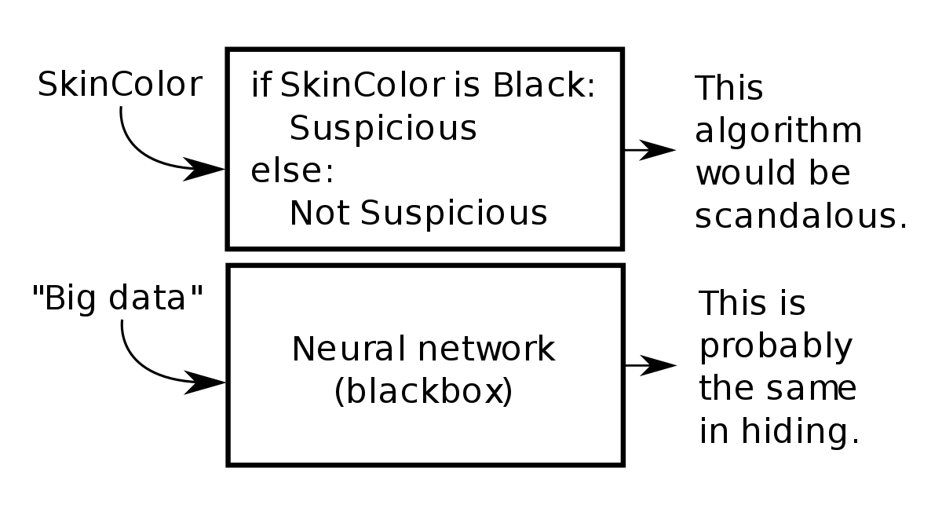

Slide 63
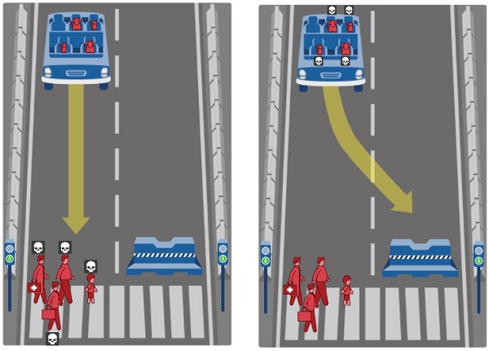

Slide 64
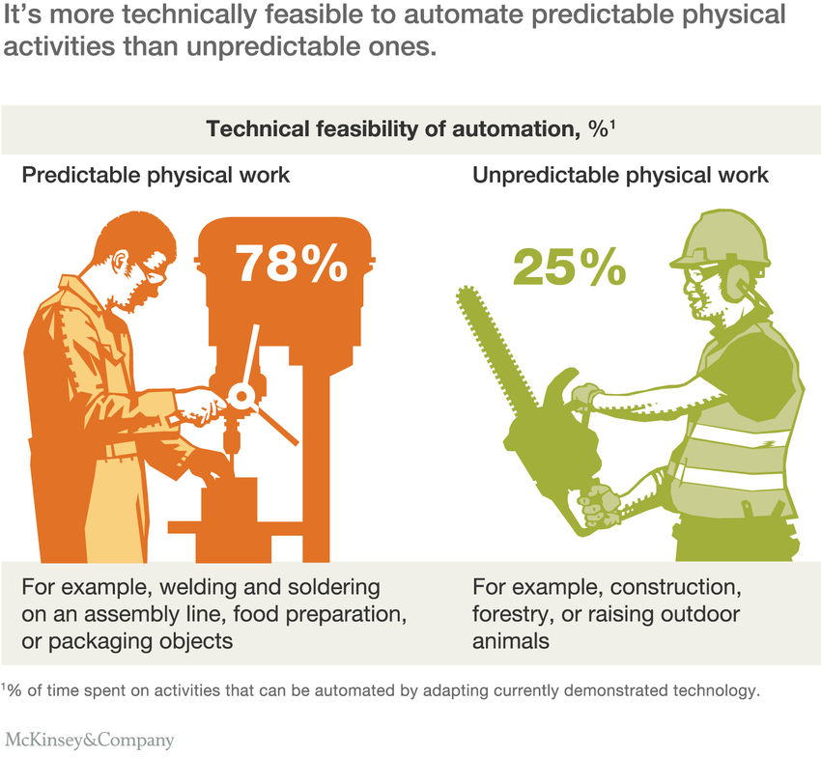

Slide 65

TFI Friday

Slide 66

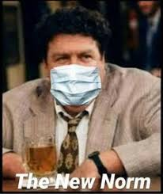
Morning session
9:00-11:00 Project definition and identifying the data sources you will work with
- Make sure to complete the form to tell us about your project!
- reach out to LT or TA if you are struggling to define a project goal/ question / hypothesis
11:00 Guest Lecture - Ian Goodrich
Lunch 12:30 - 13:30
Afternoon Session
13:30 Clustering and Data Pipeline
Self guided
-or-
walk through / code along with Flo (optional)
Submit Labs for this week
Lab optional x 2
End of Day
16:00 Share class MVPs
17:00 Last Retro of the Bootcamp
17:45 Briefing on next week - what to expect
&
End of the week Toast
Notes:
Submit your brief on the final project

